Slide 1
Plantera
Farm automation system
Supervised by: Dr/ Mahmoud Abd Alaal
T-asistant : Eng / Mohammed Hakim

Slide 2
Team members
Osama Mohamed Hussien
Ahmed Muhammad Morsi
01.
04.
Mariam Hossam
Dina Abdallah Muhamad
02.
05.
Osama Sayed Ahmed
Amira Ahmed Khater
06.
Responsible for flutter application and firebase
Responsible for ml and learning model
Responsible for flutter application and firebase
Responsible for ml and learning model
03.
Responsible for hardware and IOT
Responsible for website and firebase

Slide 3
Table of contents
Project motives
Management plan
01.
04.
Operating plan
Project Proposal
02.
05.
Timeline
Same solutions in the market
03.
06.
The problem that the project addresses and works toward solving it
Project diagrams and components
Project idea, aims, and importance
Tools and procedures
Study on the same solutions found in the market
What is done and the plan for the remaining work

Slide 4
01
Project motives
The problem that the project addresses and works toward solving it

Slide 5
Introduction
Plants are basically one of the basic cores for all living organisms,
and since our planet is facing harsh resource reduction, pollution is represented in bad minerals in the soil, etc. Also, the care is done by a lot of manpower
and sometimes despite providing the resources that the plants need, the fruits or the resulting crop are not the best quality or the maximum crop production

Slide 6
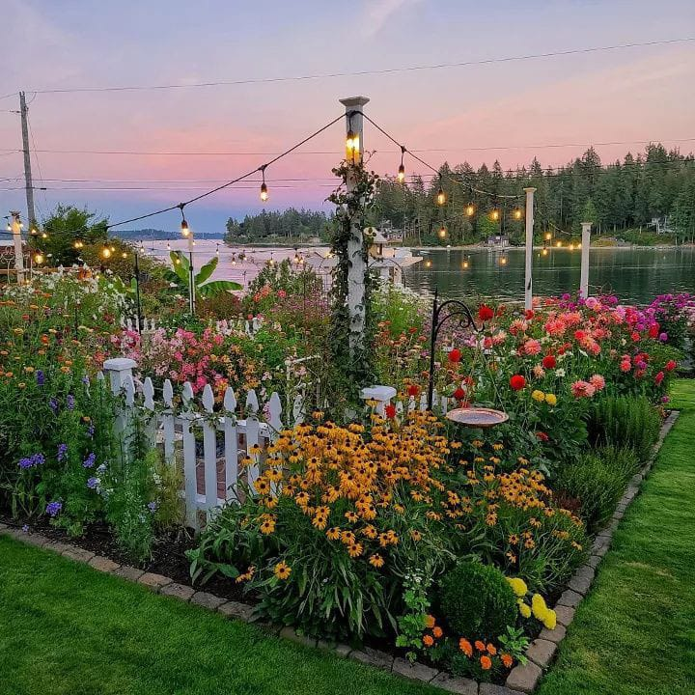
Problem & solution
Problem
Farmers waste a lot of water
Not suitable time to irrigate some types of plants.
Amount of plants damaged due to unearly discovery of diseases
Solution
A system to help farmers reduce consumption and tell when the plants need nutrition or water.
All using technology such as AI and IOT.

Slide 7
02
Project proposal
Project idea, aims, and importance

Slide 8
Project proposal
Detecting plant diseases
1.
Automating farms
2.
Feedback to the user
3.
Using deep learning model to detect diseases
Using hardware and IOT to automate farms to reduce the workers and recourses used
Creating an application to keep farmers up to date about their farm(s)

Slide 9
Project aims
Reliability
Usability
Simplicity
We aim to be a reliable form of information for our farmers, providing them with correct data, and helpful information.
We aim for a usable system, that would help solving many problems
Reductional
We aim to produce easy to use system that can provide ease of use for all farmers
We aim to reduce the effort done by farmers and reduce the recourses to the needed amount

Slide 10
Project importance
Reduction of resources waste
Early detection of diseases to help cure them as soon as the disease is detected
High-quality crops as the needed nutrition are given to the crops
Give feedback to the farmer about the farm

Slide 11
03
Study on the market
Study on the same solutions found in the market

Slide 12
Others in the market
01.
02.
03.
A system that can irrigate plants intelligently only
A system that searches for plant diseases
A system for crop prediction

Slide 13
Competitor analysis
 | Plantix | planta | Agrio | Leaf doc
Detect plant diseases | Yes | No | Yes | Yes
Plant care | Yes | Yes | Yes | No
Automation | No | No | No | No

Slide 14
Them
Us
Each solution tries to solve each problem independently
Our goal is to solve more than one problem and integrate it into a broader system that can intelligently irrigate, intelligently detect plant diseases, predict crop yields, and make farmers control the system via a smartphone.

Slide 15
04
Management plan
Project and its components

Slide 16
Our system
01
02
03
04
Mobile application
Website
Deep learning
Hardware

Slide 17
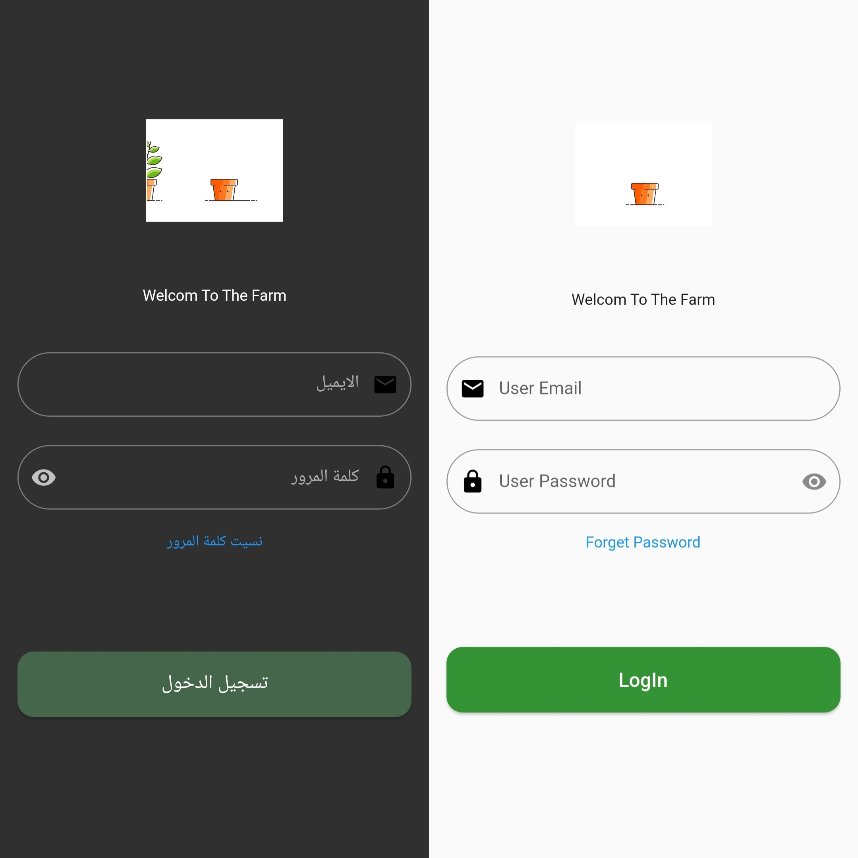
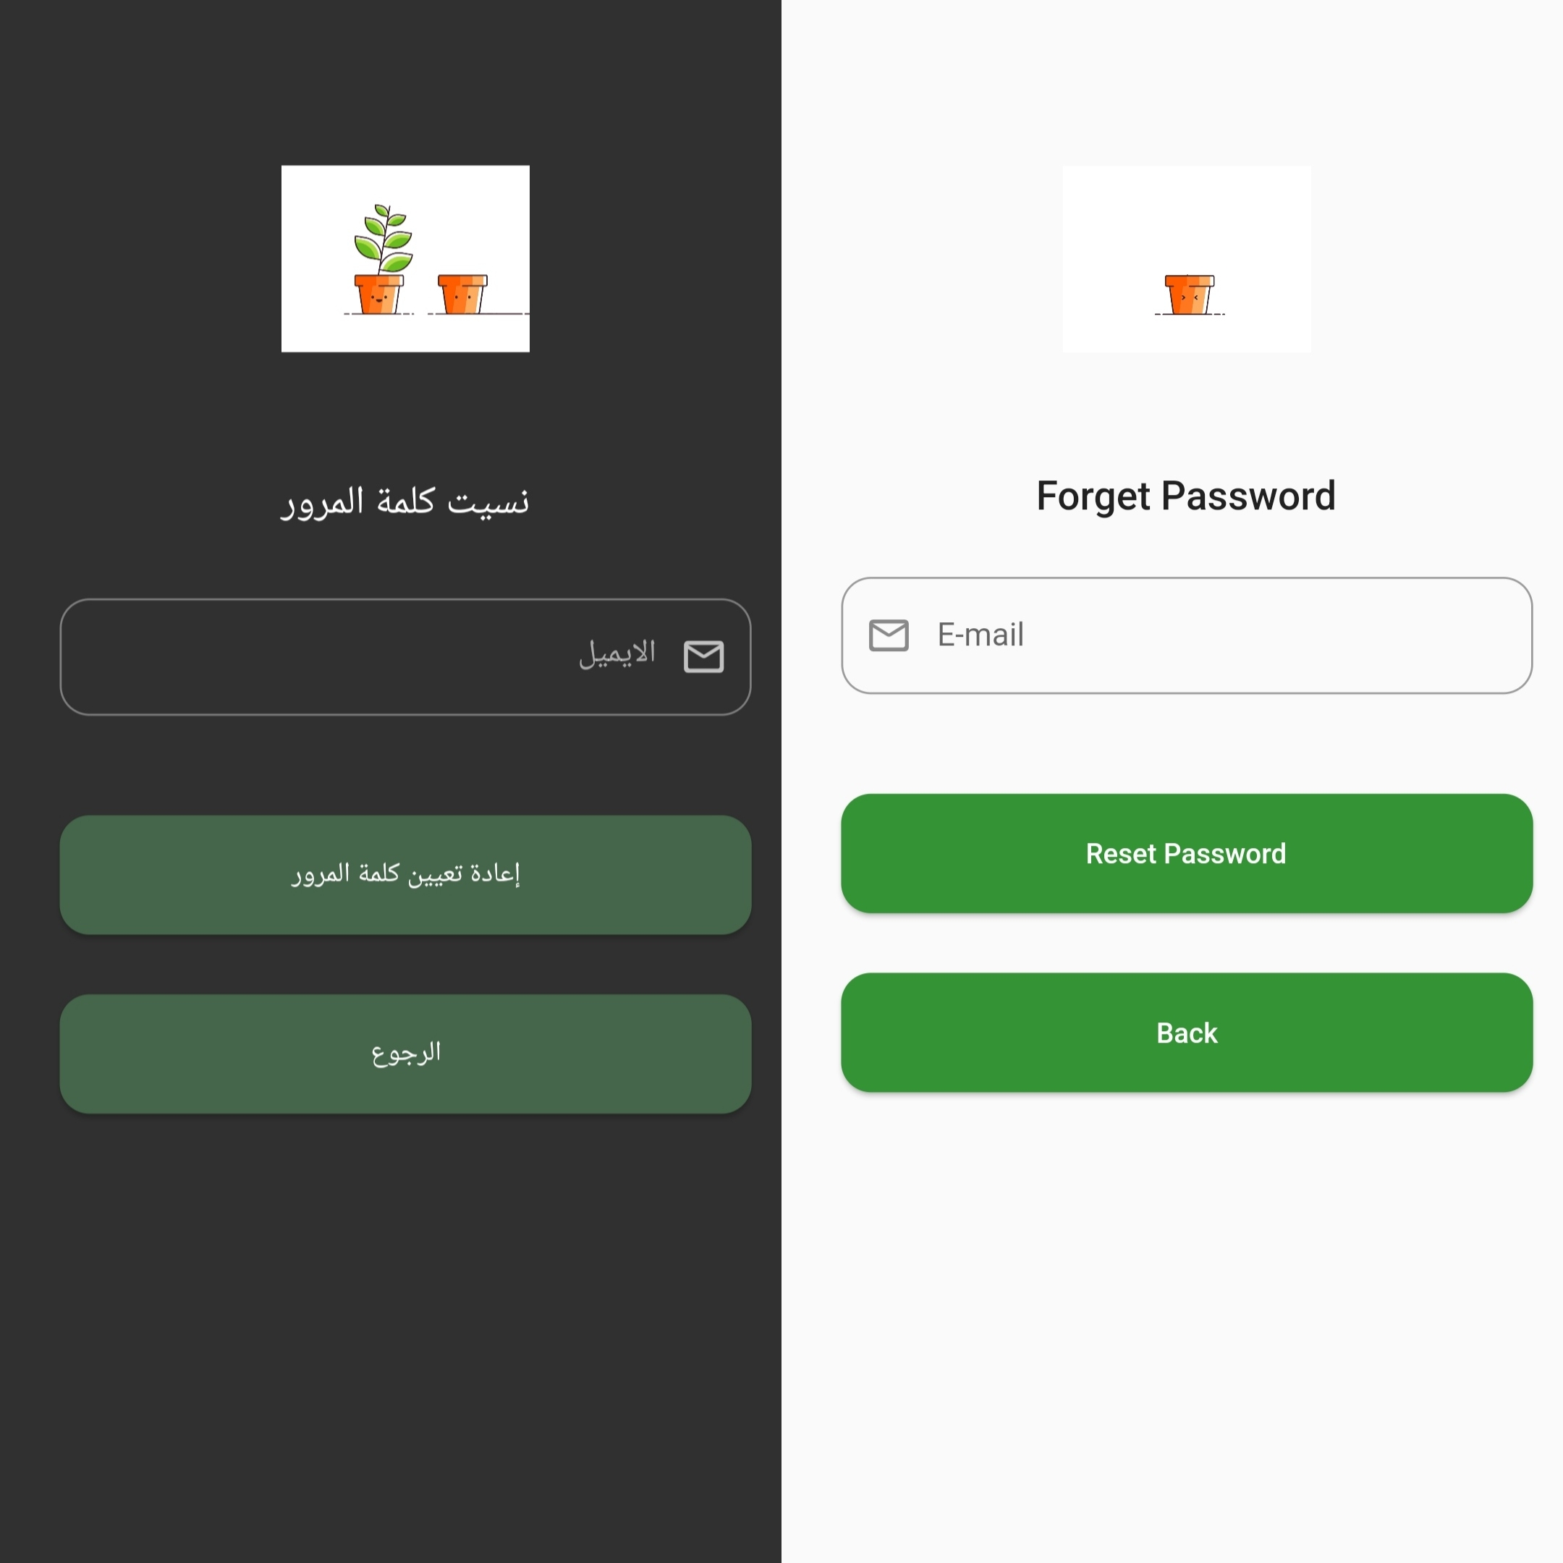
Flutter application login and forget the password page

Slide 18
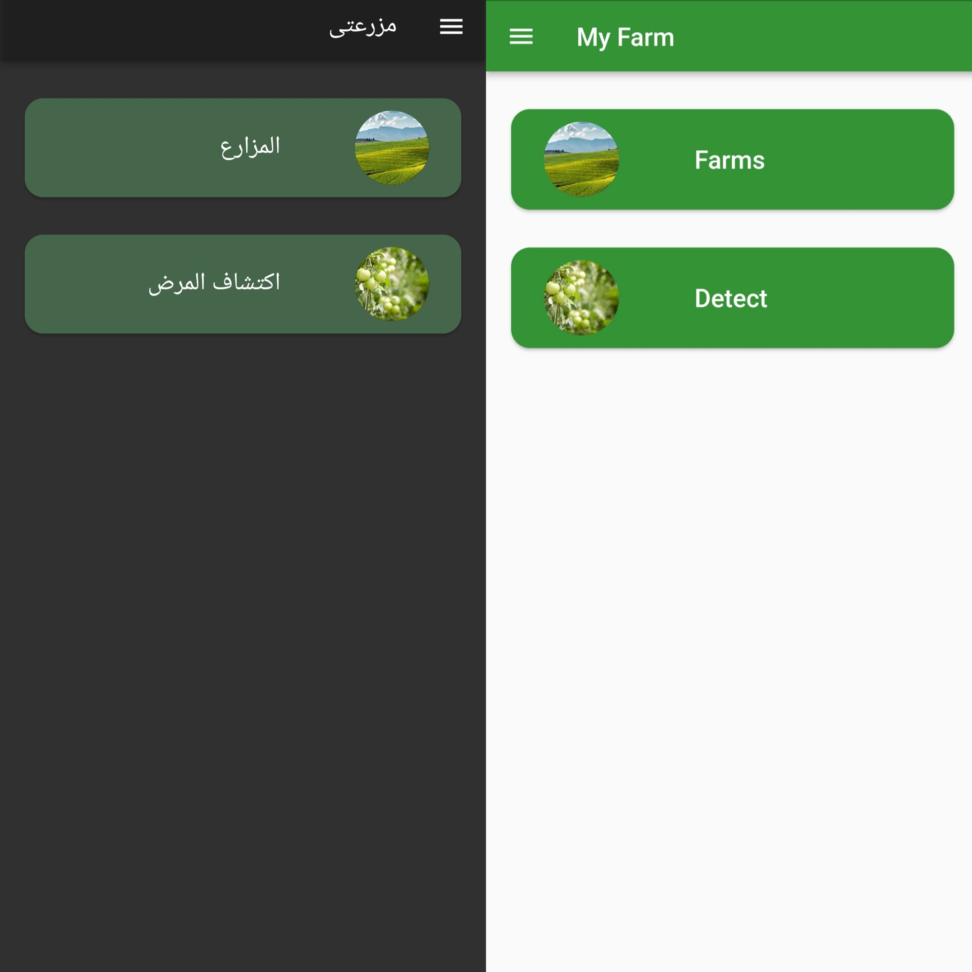
Flutter application Main page when logging in
The main page contains 2 buttons,
The first one gives the user access to their farms and information about the farm.
The second button leads to a page to either capture a picture or use an already existing one for detecting plant diseases

Slide 19
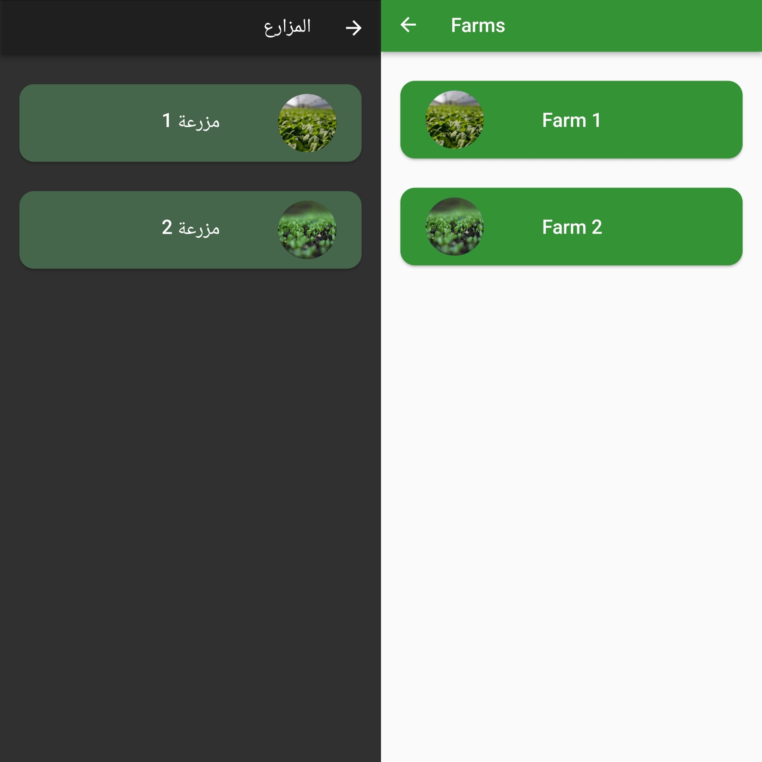
Flutter application farms feedback page
This page gives the user access to the farms they have logged into the system and pressing each button gives information about the farm.

Slide 20
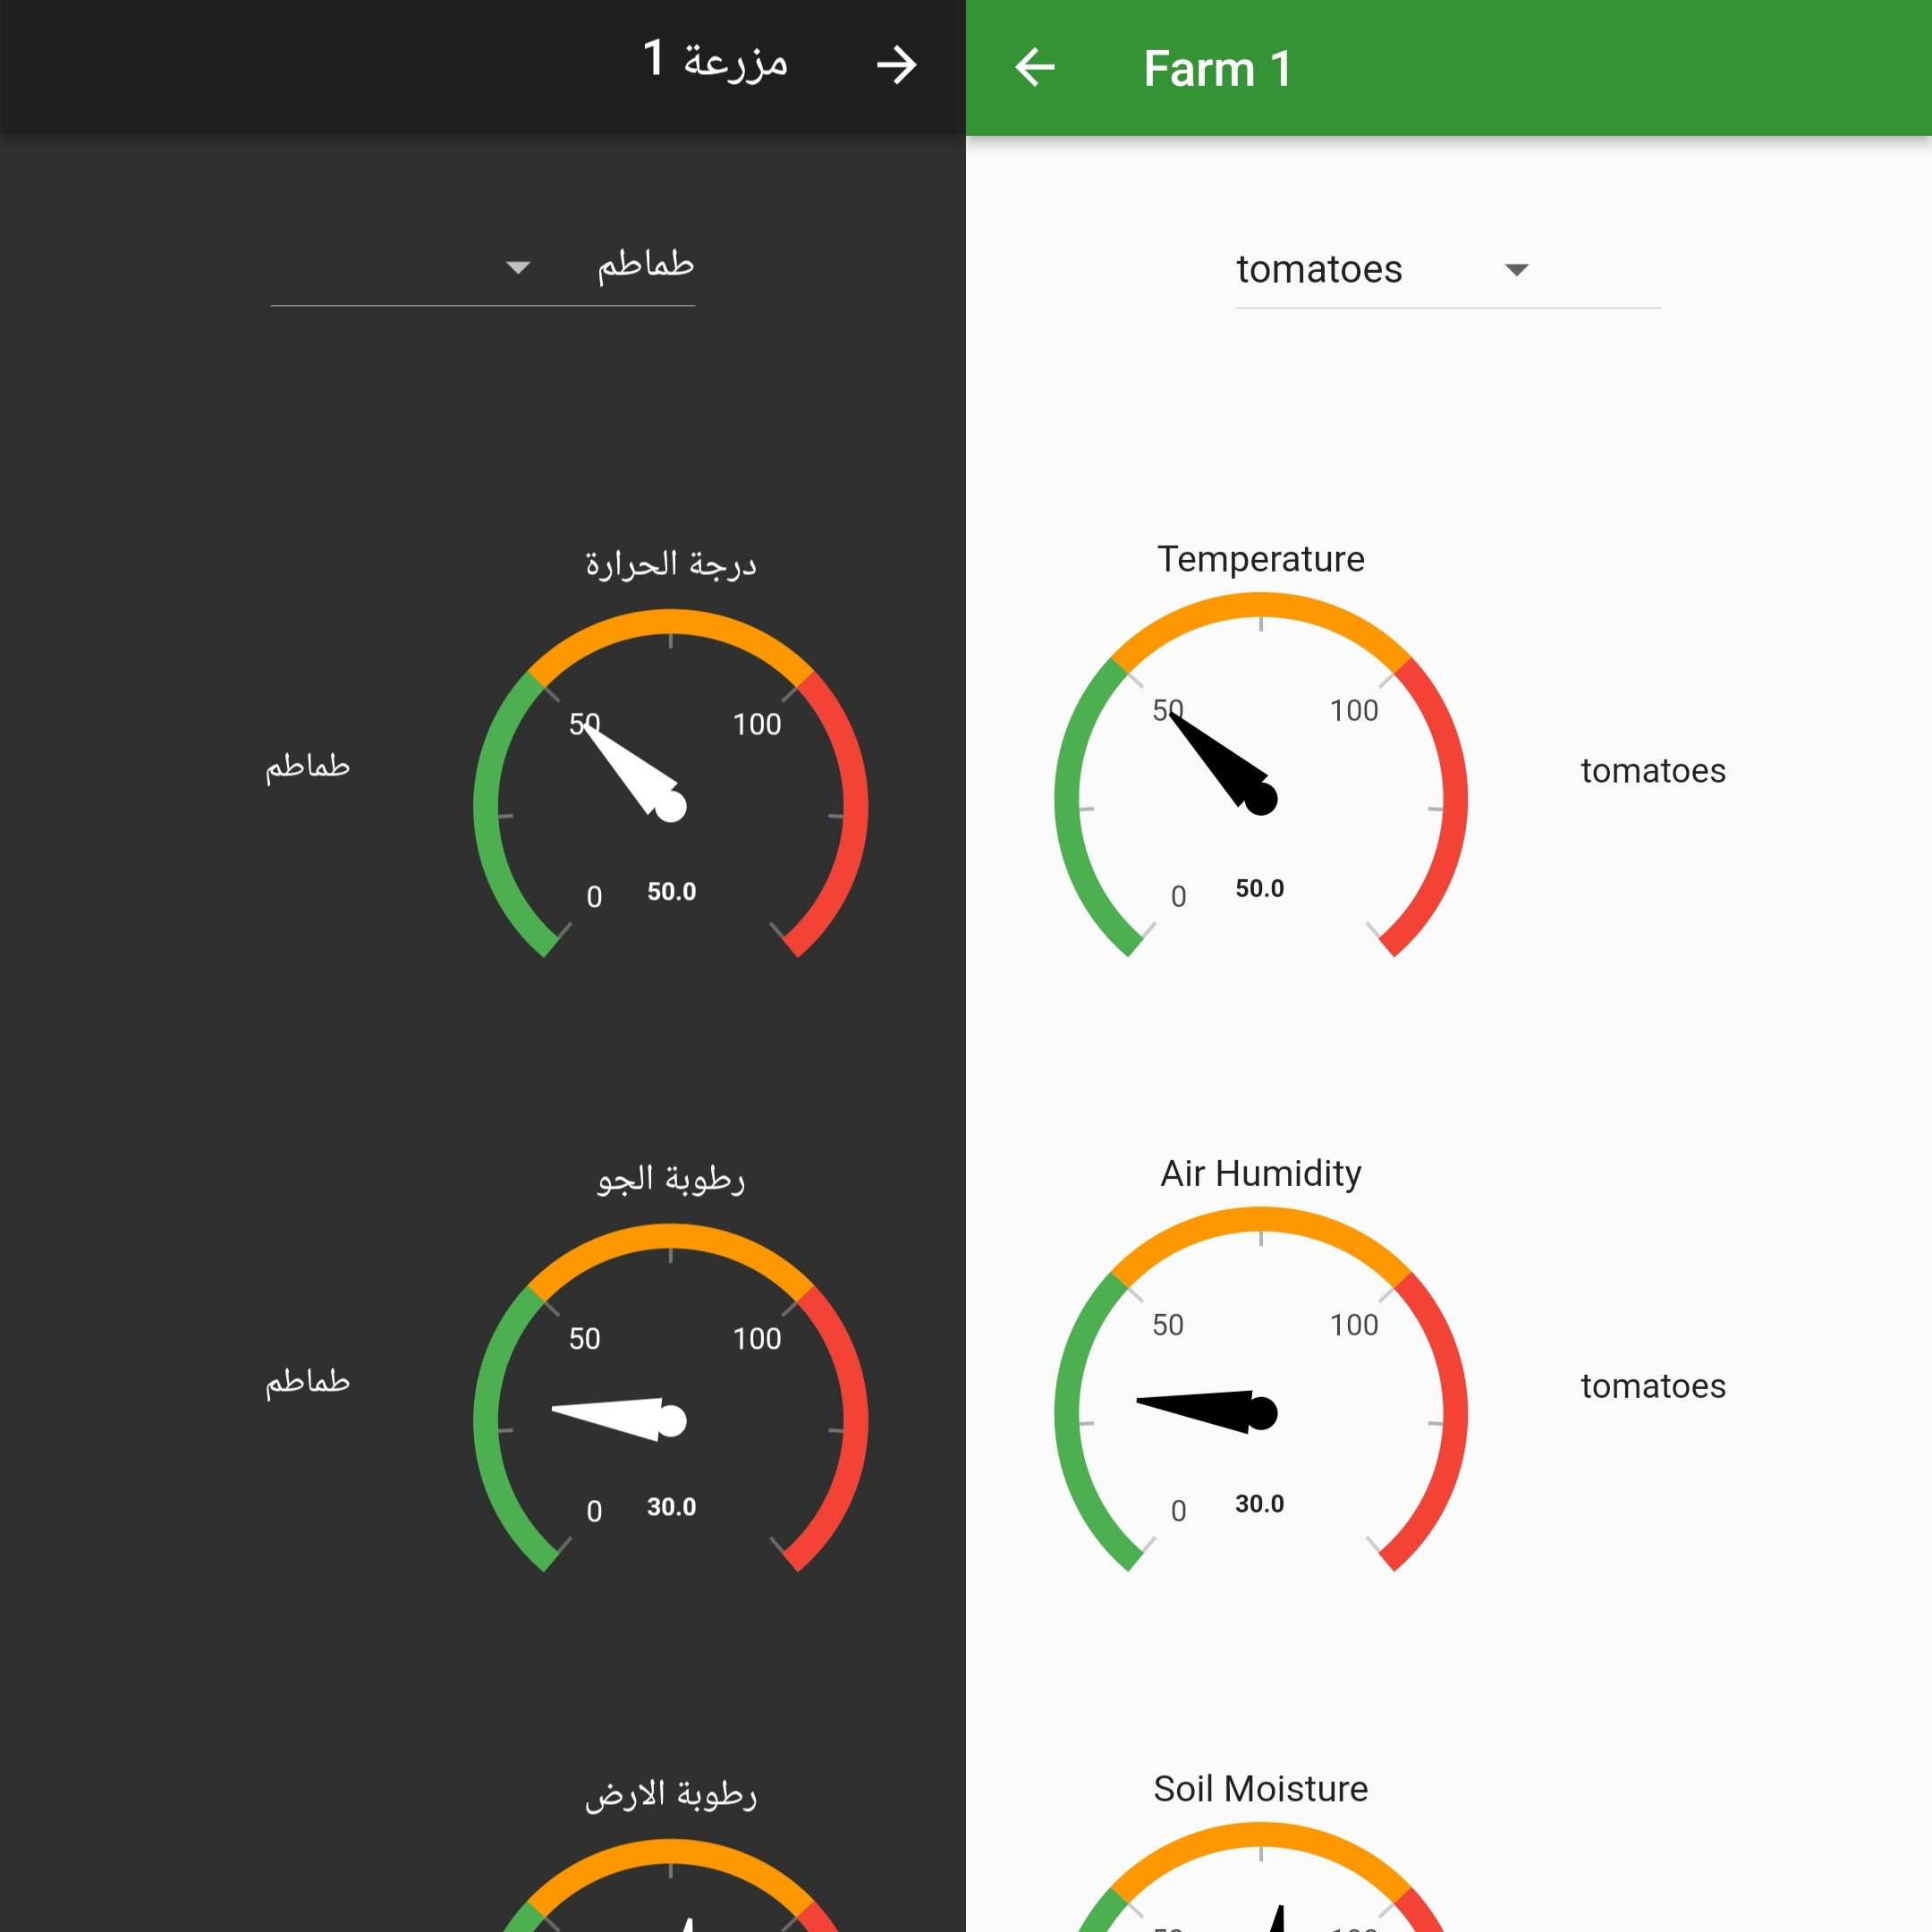
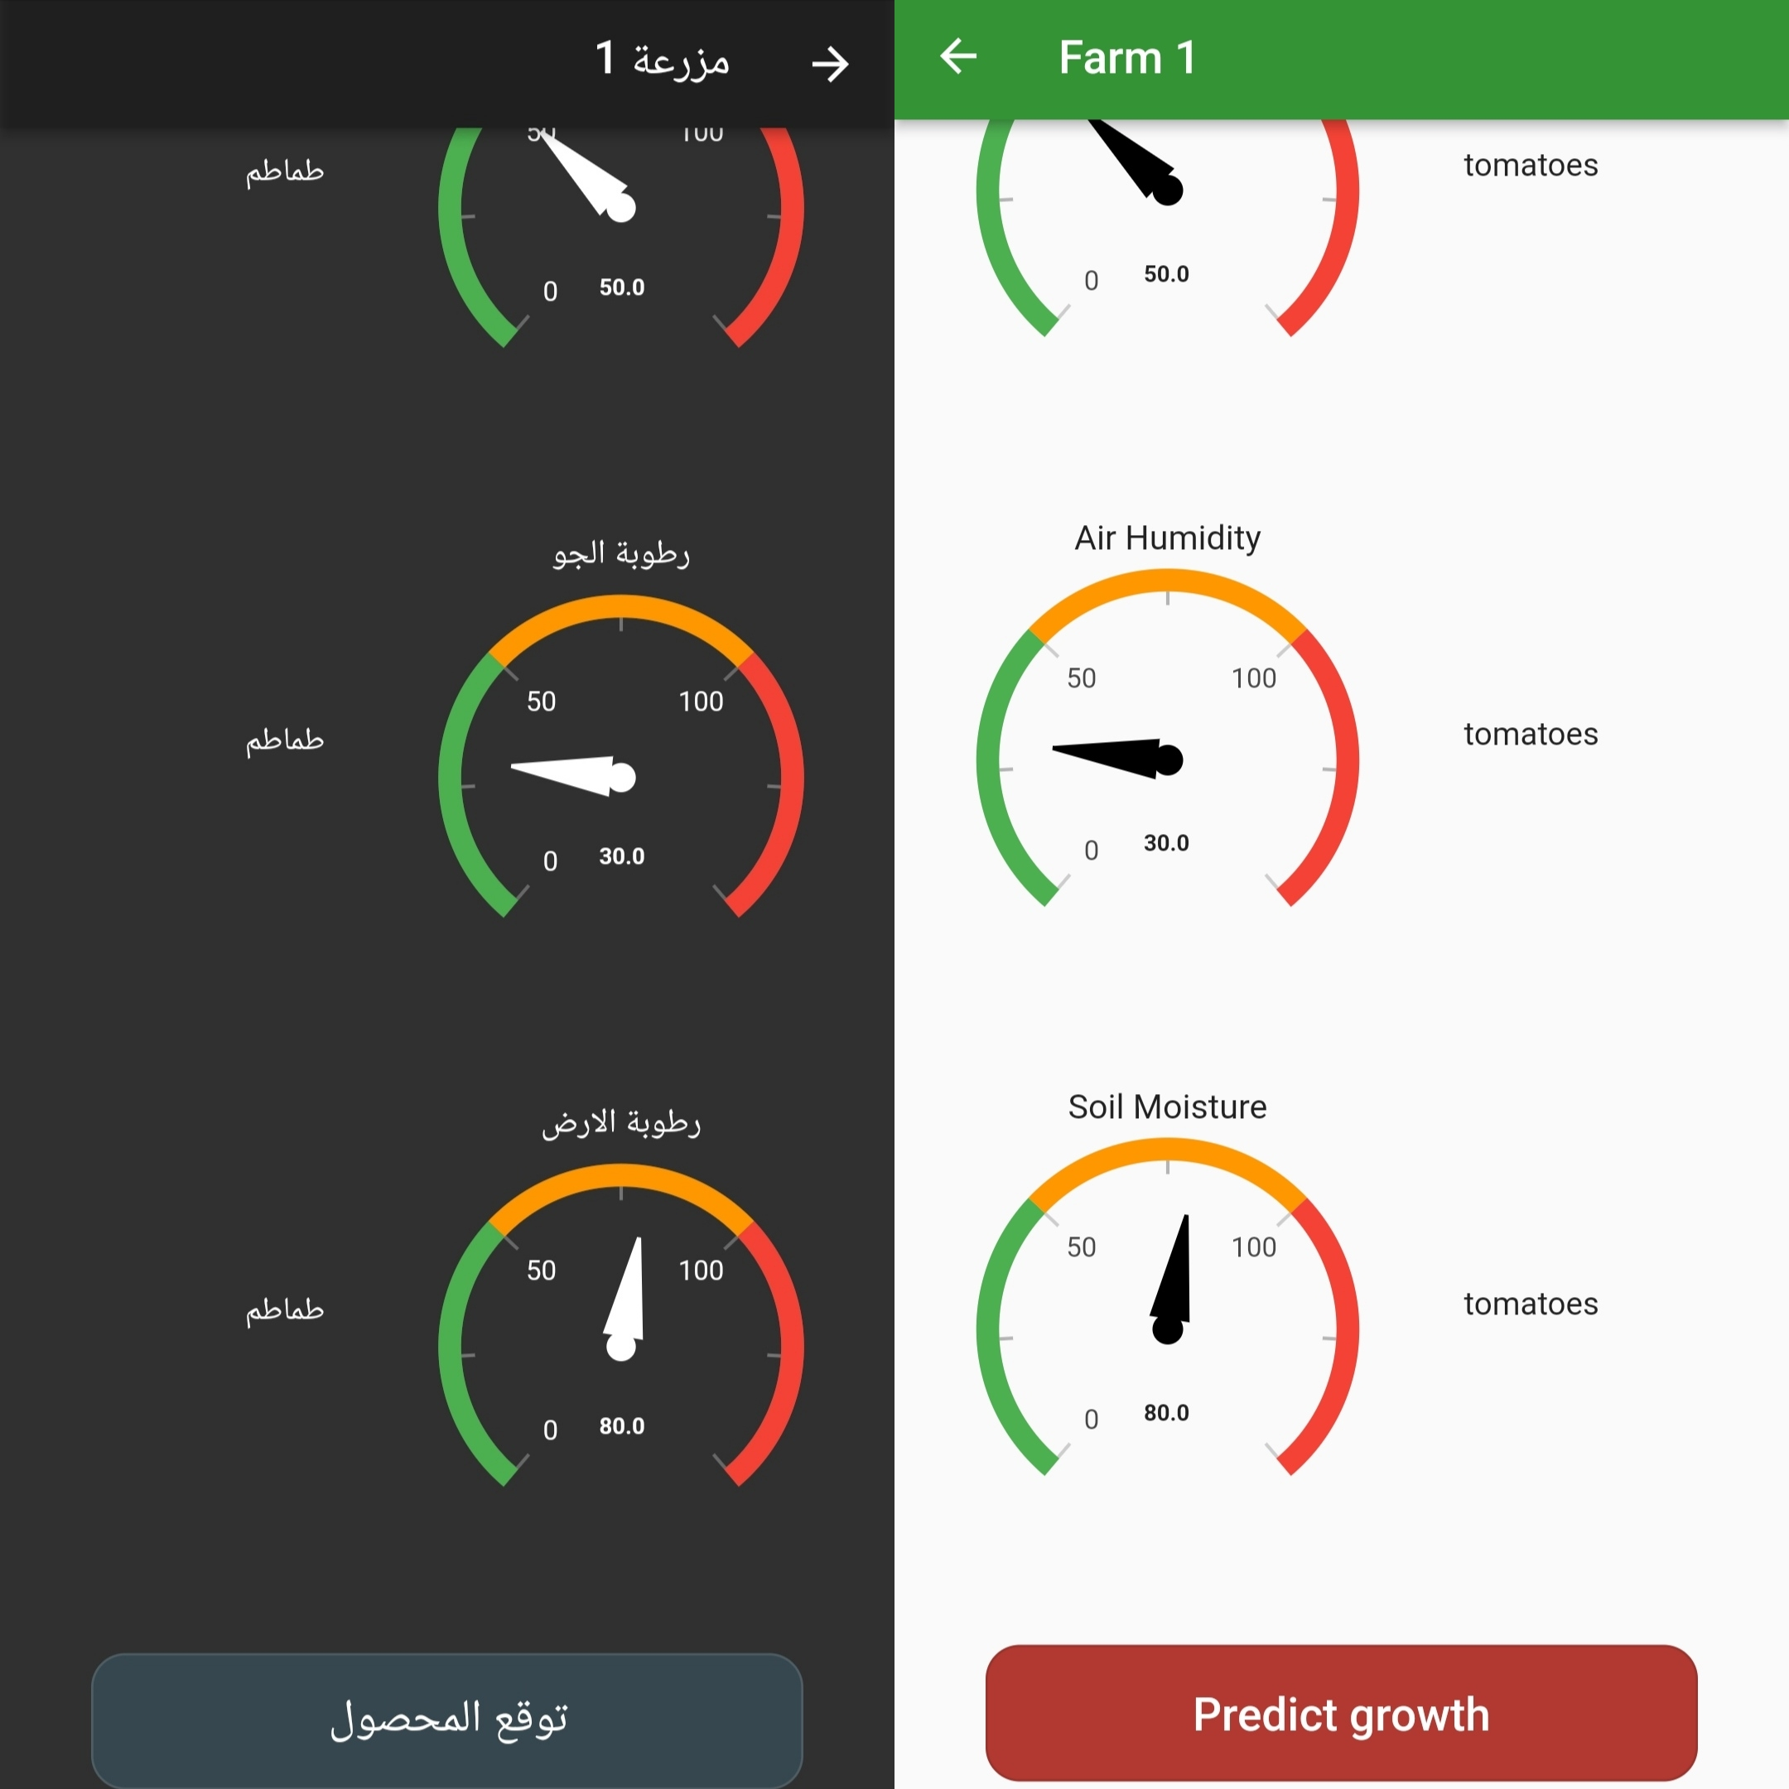
Flutter application farm feedback page

Slide 21
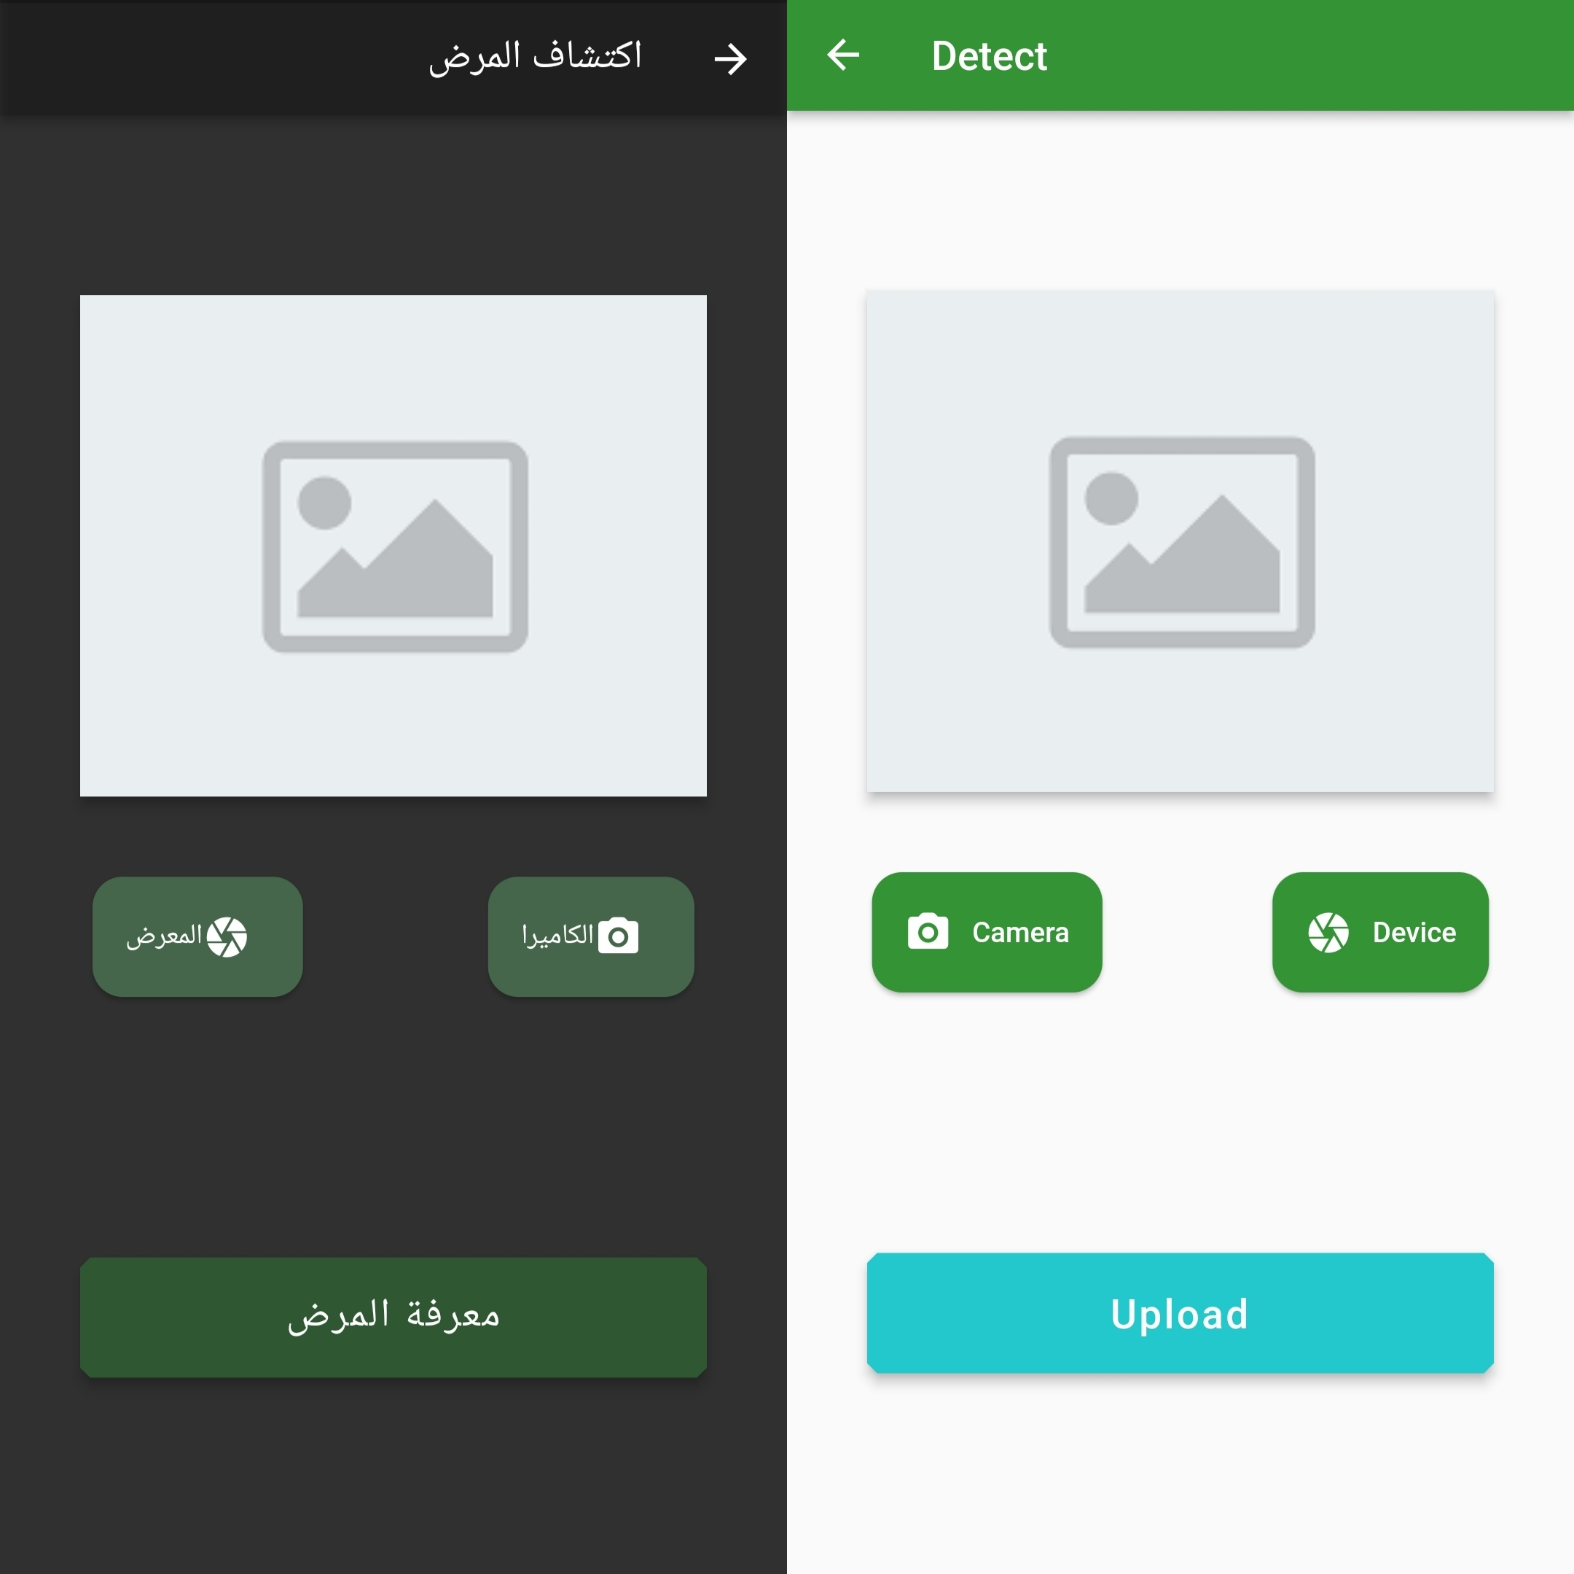
Flutter application Plant disease detection page
page to either capture a picture or use an already existing one for detecting plant diseases

Slide 22
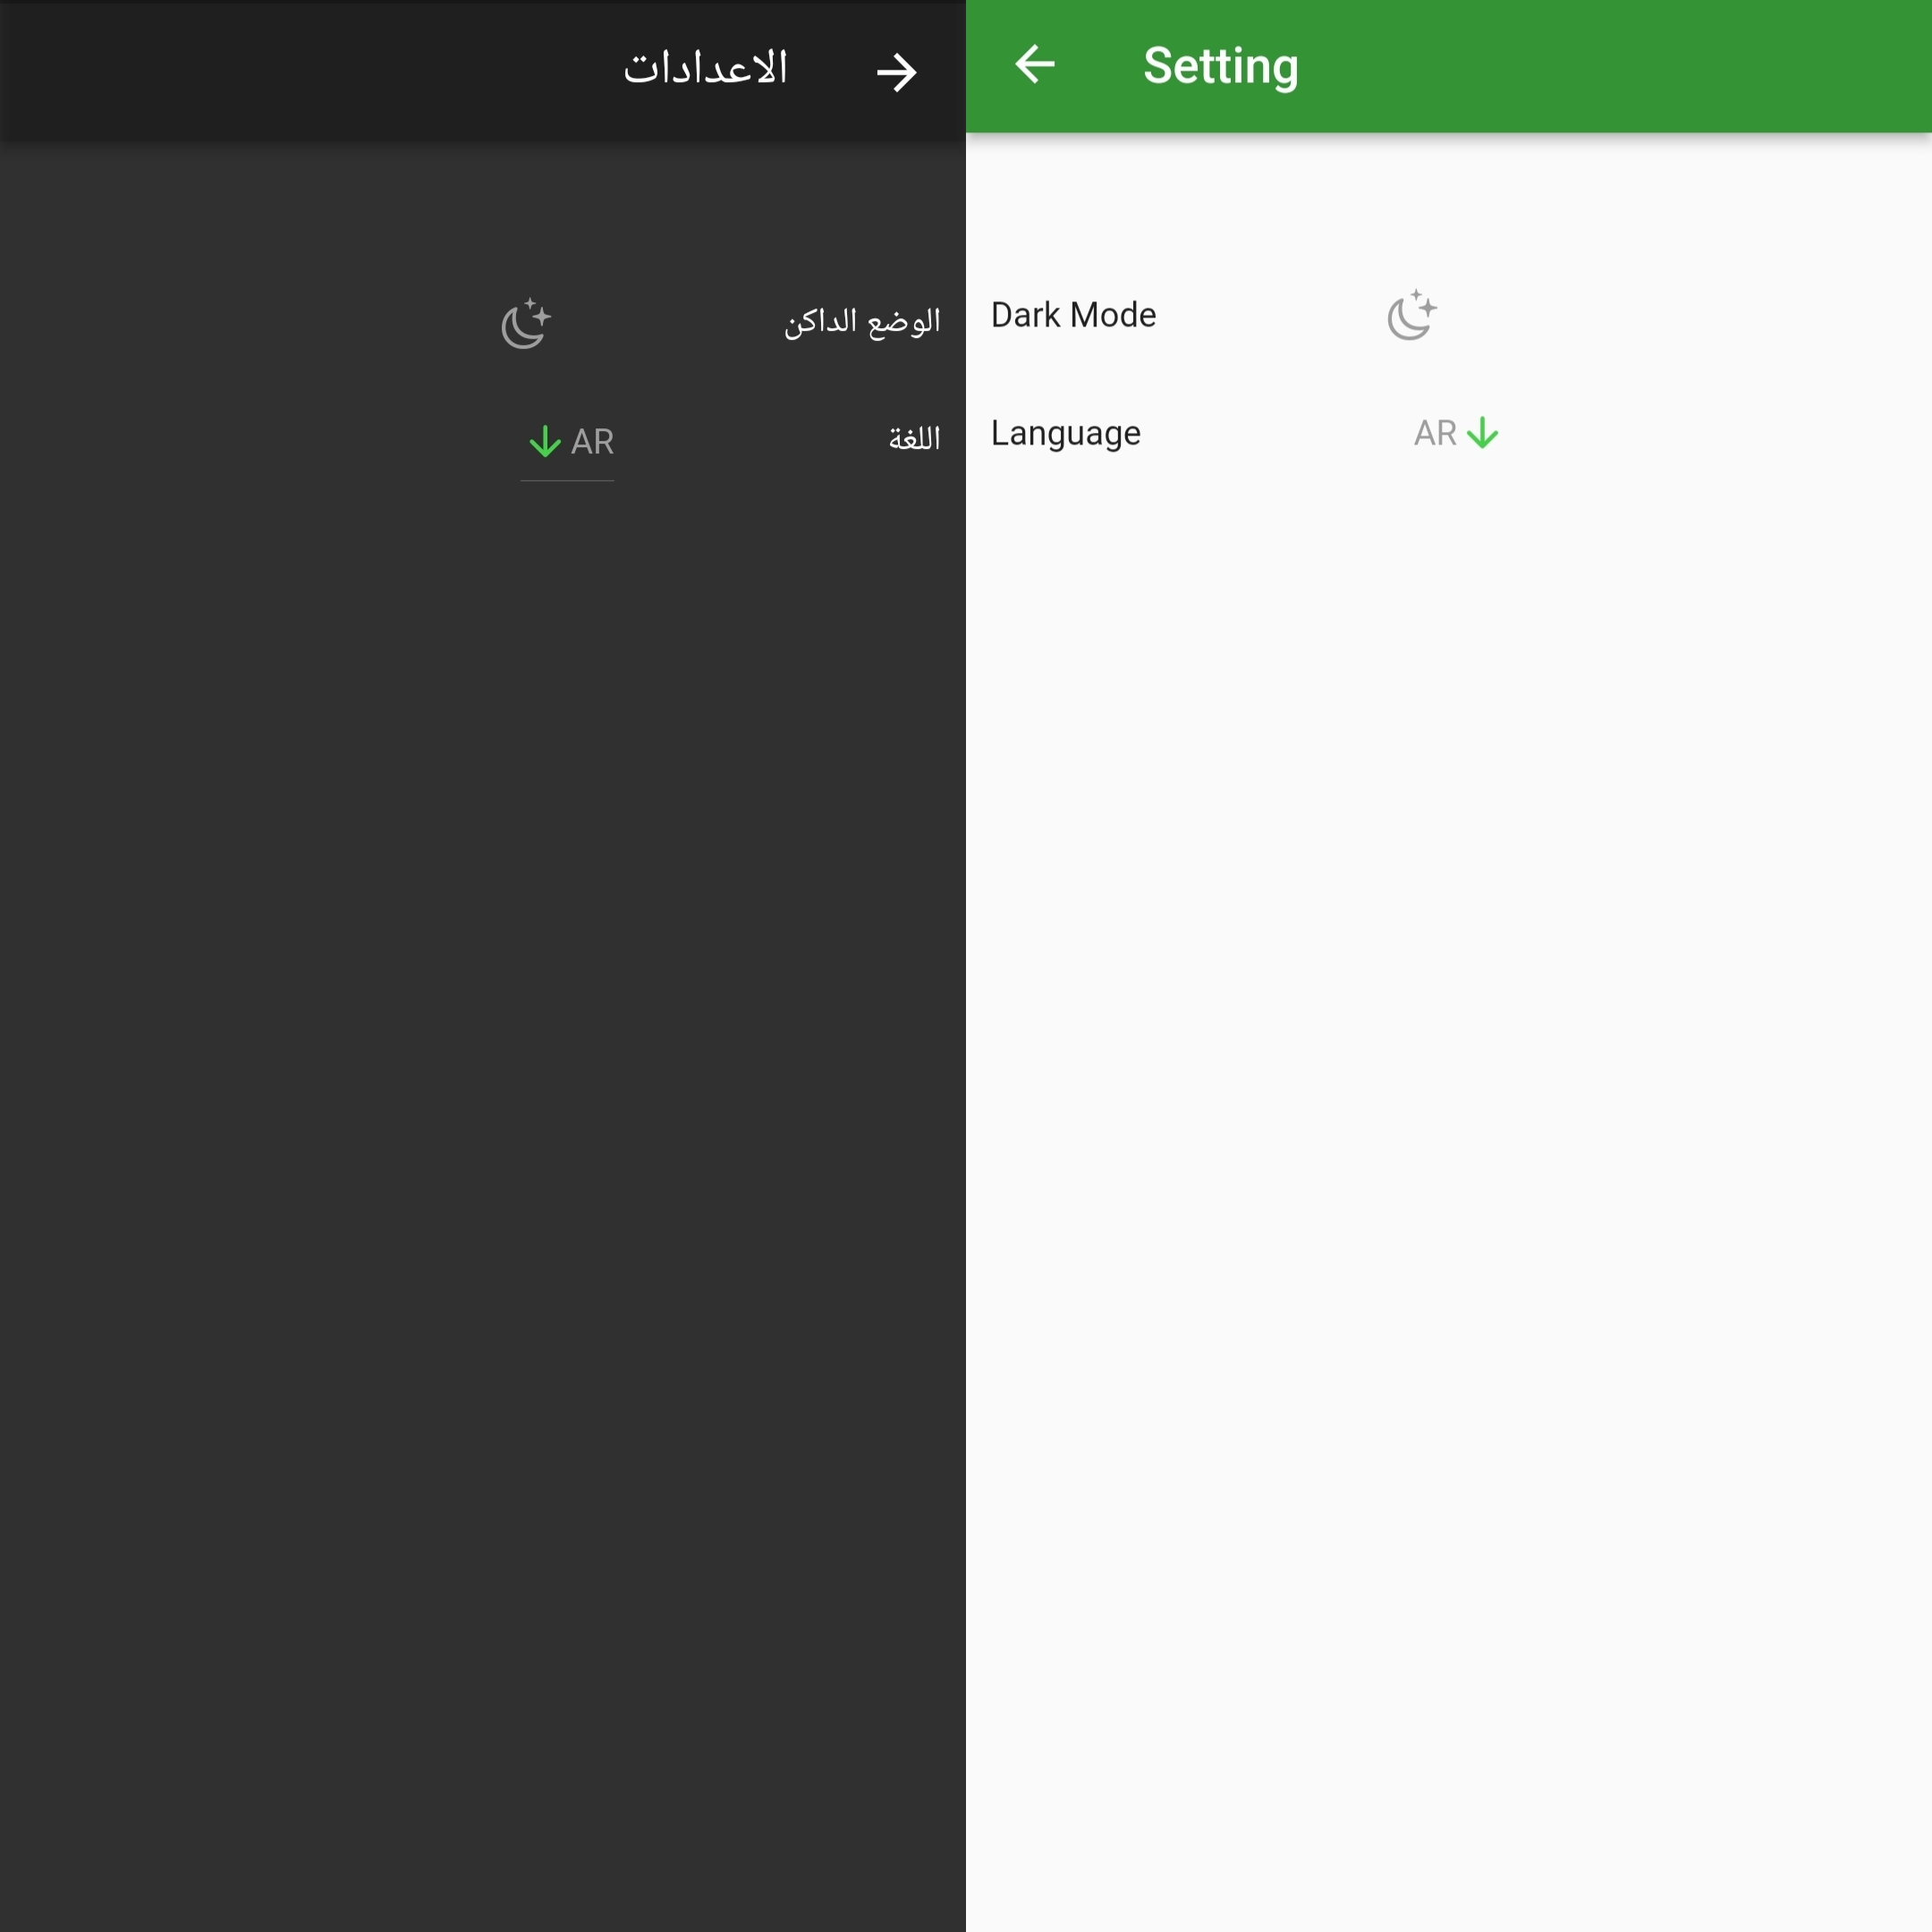
Flutter application dark mode and language option
For ease of use for the user we include 2 languages and both light and dark mode

Slide 23
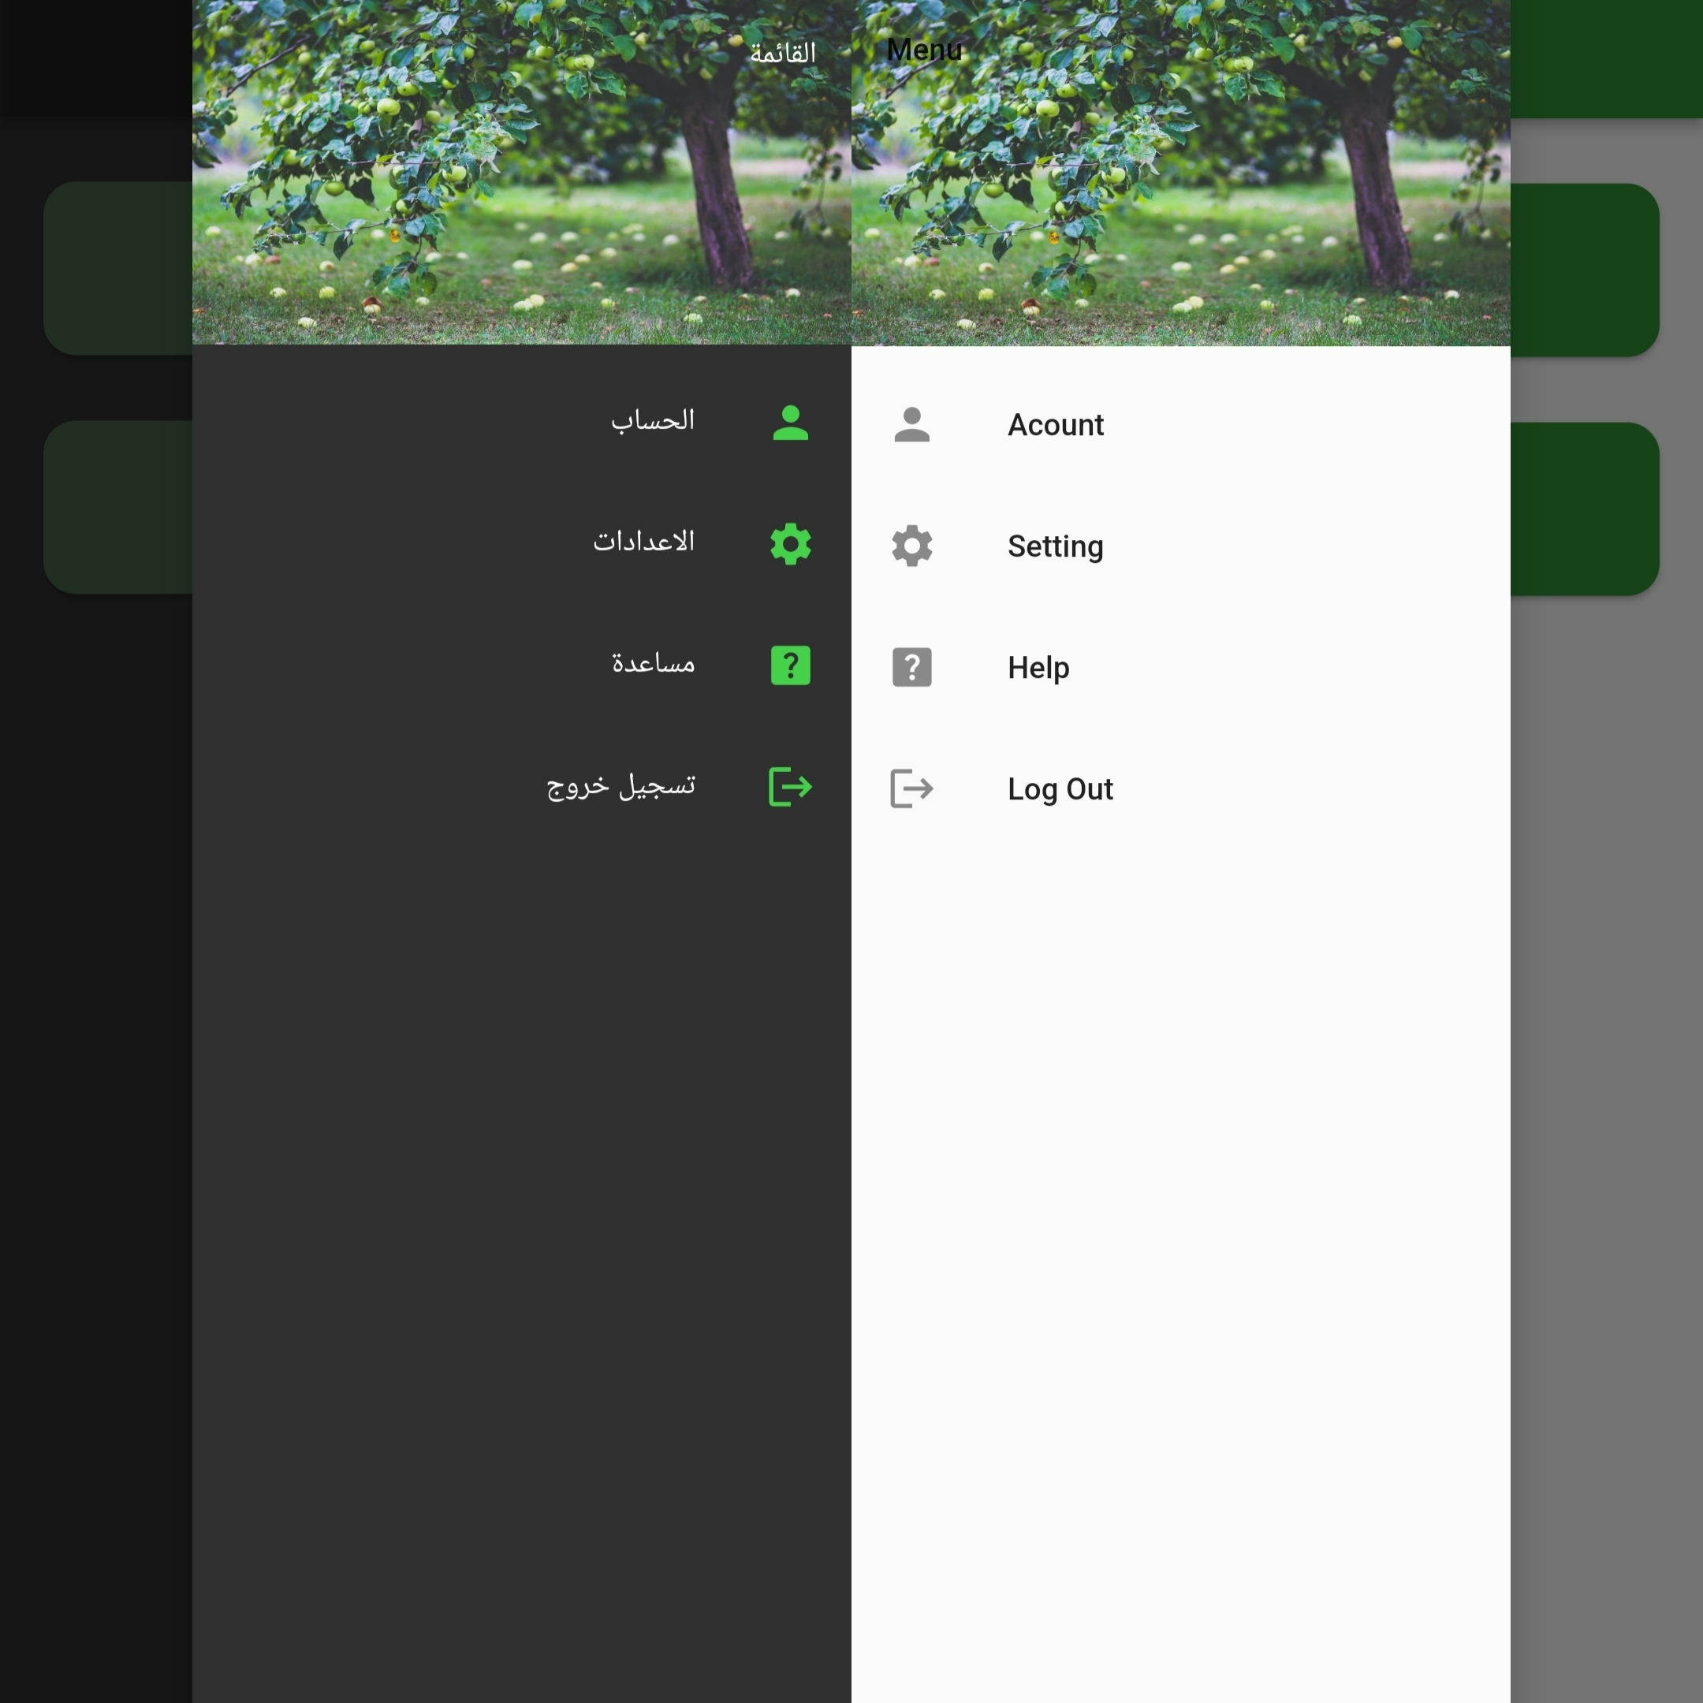
Flutter application profile page
Profile page where the users can access their accounts, have the setting for the application, get help, and log out

Slide 24
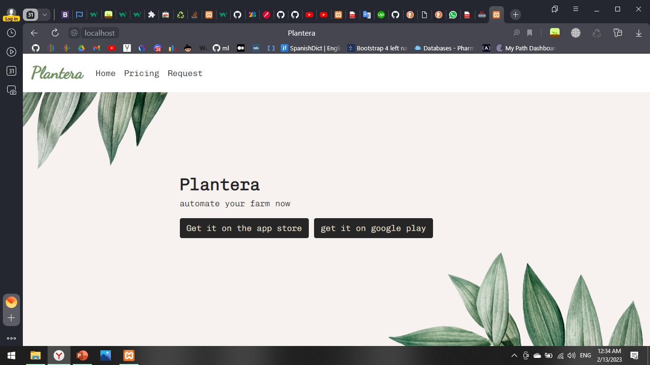
website
The home page, where the user can install the application on both the apple store, and google play

Slide 25
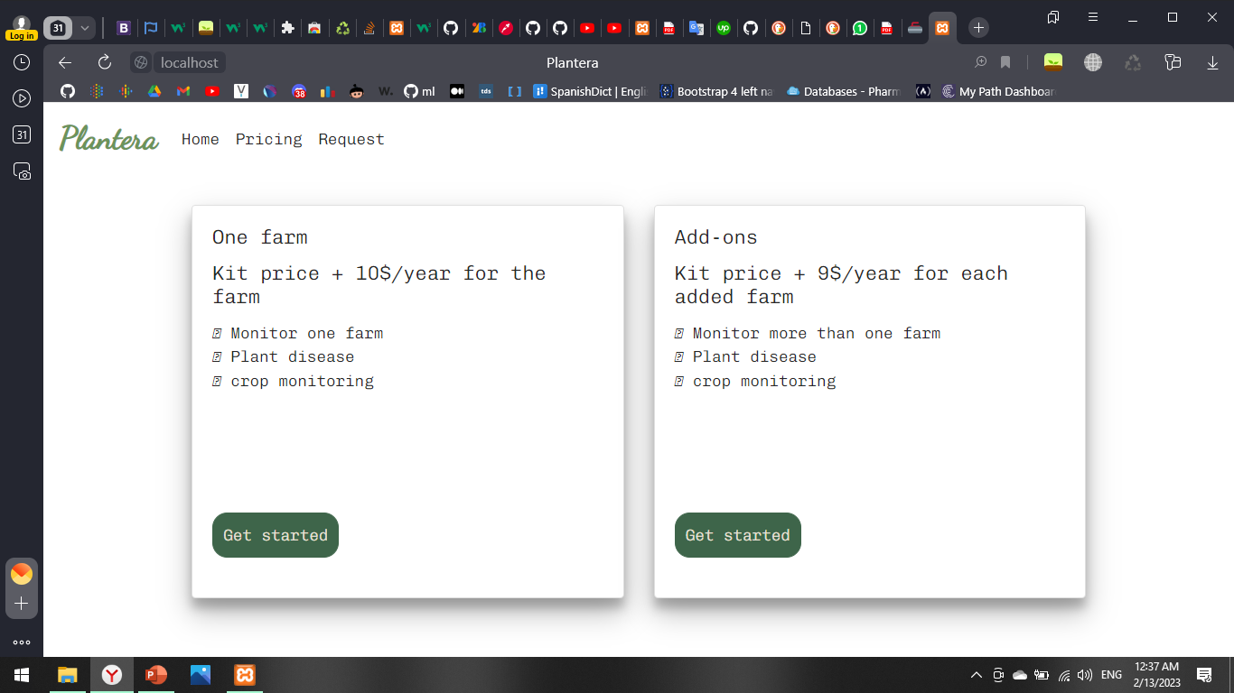
website
Pricing page, where all the plans are available is giving to the user

Slide 26
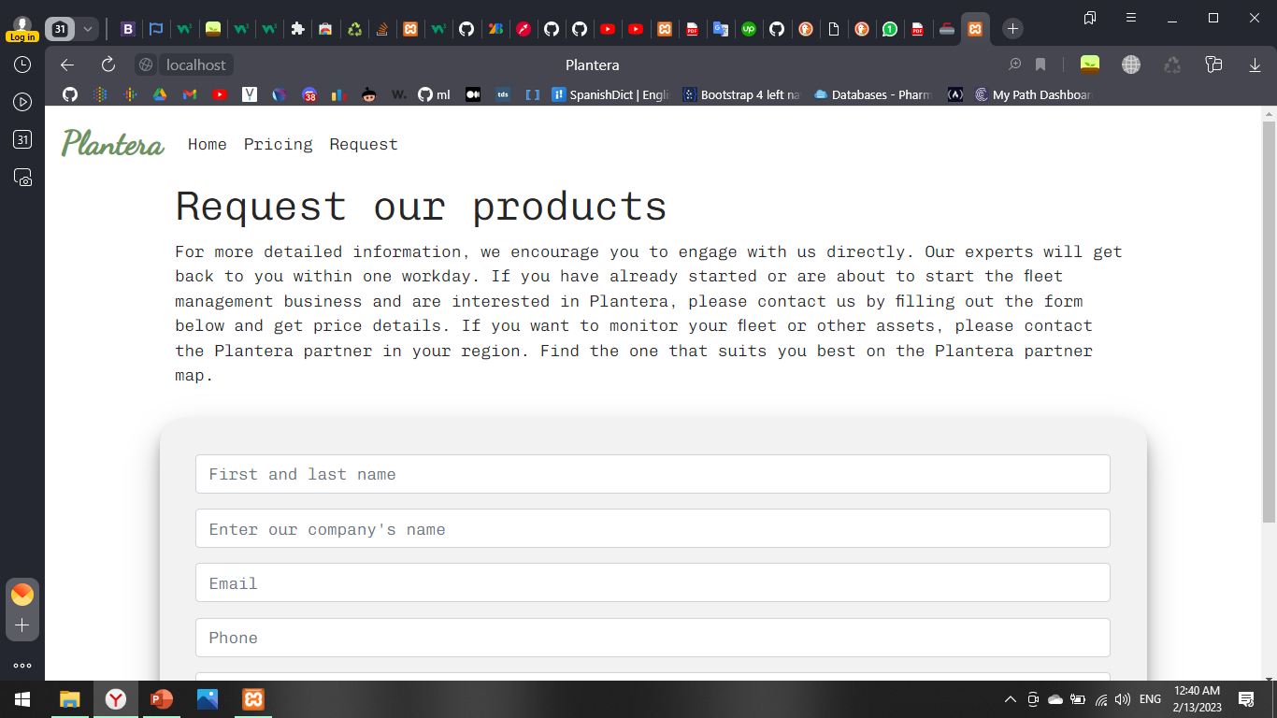
website
Request page where the user can request to have the system installed

Slide 27
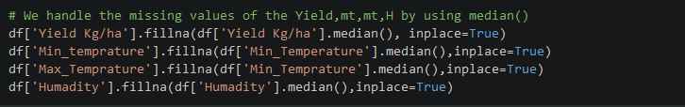
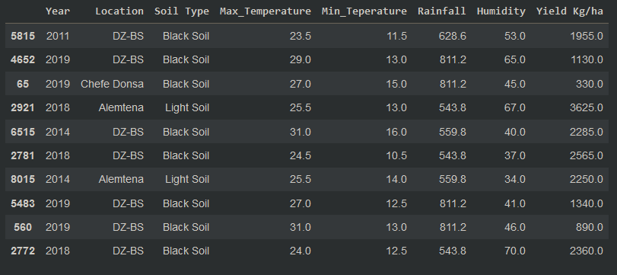
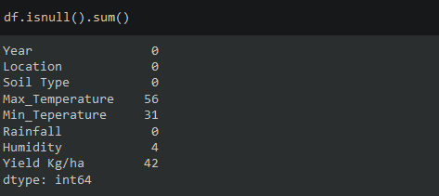
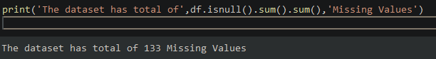
CropYeild Prediction model
Data Preprocessing step:

Slide 28
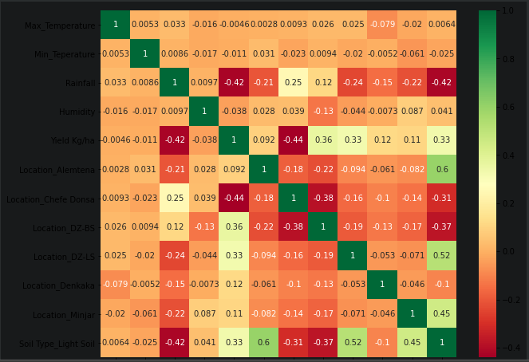
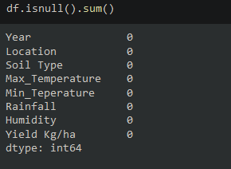
CropYeild Prediction model
Data Preprocessing step:

Slide 29
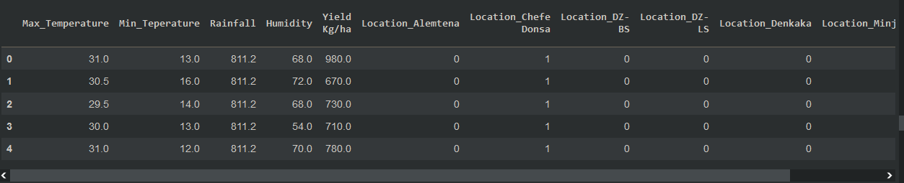
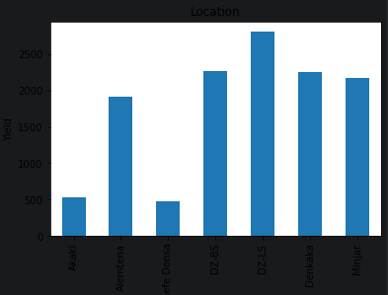
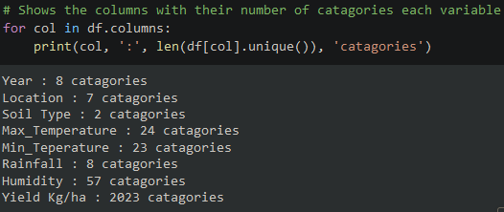

Slide 30
Plant disease model
We used a pre-trained model to train the dataset we have:
Why did we use a pre-trained model?
A pre-trained model is a saved network that was previously trained on a large dataset typically on large-scale image-classification task

Slide 31
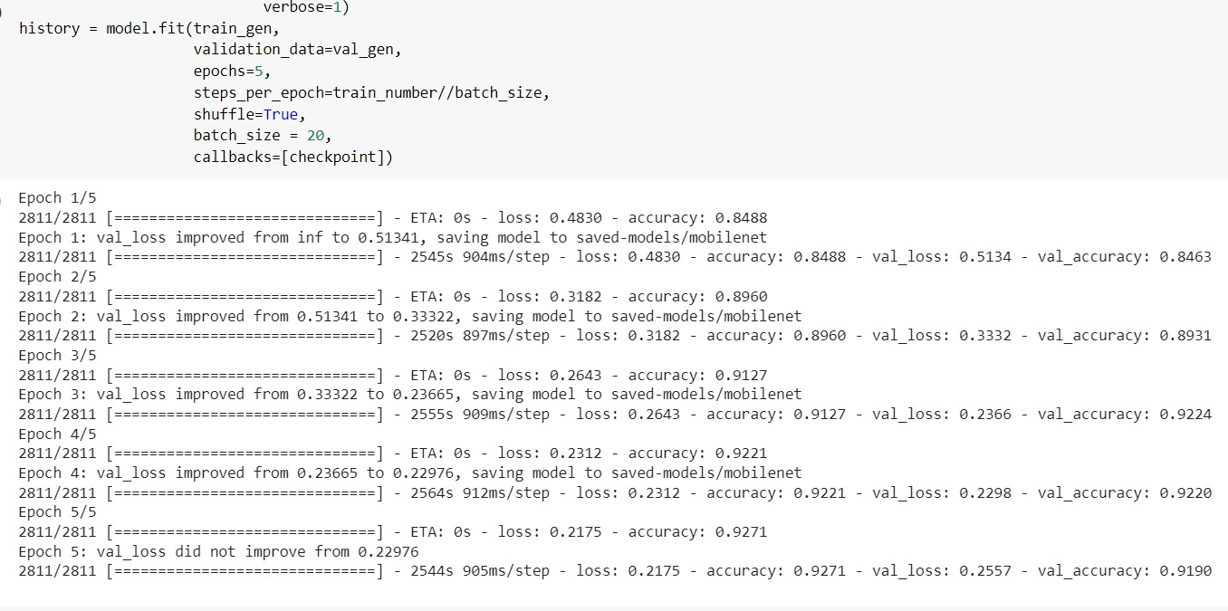
Plant disease model
We used a pre-trained model to train the dataset we have:

Slide 32
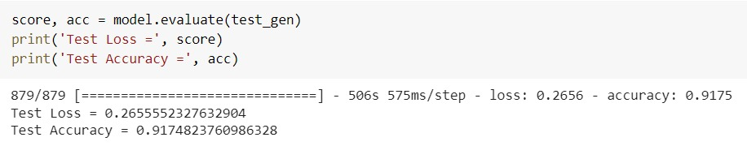
Final plant disease model accuracy
Final accuracy result :

Slide 33
05
Operating plan
Tools and procedures

Slide 34
Our system
01
02
03
04
Mobile application
Website
Deep learning
Hardware

Slide 35
Tools
Flutter
Python3
Php
Javascript
MobileNet
Arduino
Flask
Firebase
Tensor flow

Slide 36
Hardware tools
PH Sensor kit (Water Acidity Measurements)
Soil Humidity Sensor Controller System
Temperature & Humidity Sensor
Rain Sensor
Water pumpL298 Module Red Board
Solar Panel
Lead acid Battery
Solar charge controller
microcontroller NodeMcu

Slide 37
Procedures
Searching for a dataset of plant diseases, using pre-trained models we trained the dataset we have after doing preprocessing, and choosing a model with high accuracy. Meanwhile, We were designing the flutter app UI and building it, also while working on the flutter website was being built.

Slide 38
06
Timeline
What is done and the plan for the future

Slide 39
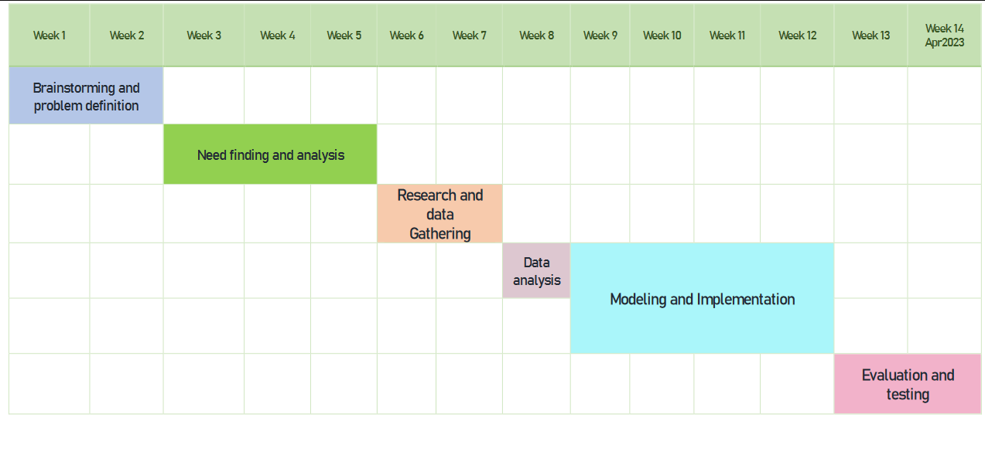
Model Grant chart

Slide 40
What is done so far
Flutter mobile application interface
Website frontend for users
Plant disease detection
Study about all the needed hardware components

Slide 41
What is needed to be done
Website backend
Firebase
API to host the model
Hardware
Mobile application backend

Slide 42
Plan to finish the project
Week 1 | Week 2 | Week 3 | Week 4 | Week 5 | Week 6 | Week 7 | Week 8 | Week 9
Work on hardware |  | Connect application with hardware |  |  | Connect application with web
Work on the website’s backend and Firebase
 |  |  |  |  |  |  |  | API
10th and 11th weeks to test

Slide 43
—Audrey Hepburn
“To plant a garden is to believe in
Tomorrow.”

Slide 44
Thank you

